Slide 1
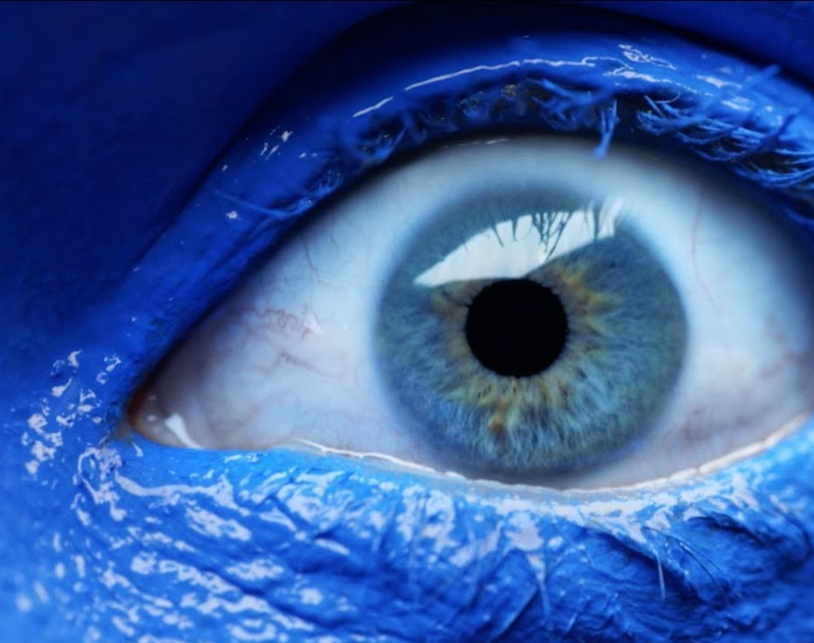
Bonus: The Blue Eyes Paradox

Slide 2
The Blue Eyes Paradox
300 people live on an island. 100 have blue eyes, 100 have green eyes, and 100 have brown eyes. Nobody knows their own eye color, but they can see everyone else’s eye color.
Island customs forbid you from learning your eye color, including using a reflective surface or by asking a friend. If you accidentally learn your eye color by any means, you must leave the island at daybreak, never to return. All islanders learn who (if anyone) has departed each morning.
One day, you visit the island. While greeted by all the islanders, you announce: “I can see at least one person with blue eyes.” Of course, everyone already knew this, even before you said it out loud.
What happens in the following days?

Slide 3

The Blue Eyes Paradox
300 people live on an island. 100 have blue eyes, 100 have green eyes, and 100 have brown eyes.
Nobody knows their own eye color.
Each daybreak, everyone who has learned their eye color must leave.
I can see someone with blue eyes
Yeah we already knew that
No new information was given, so nothing new will happen … right?

Slide 4
The Blue Eyes Paradox
3
1
1
300 people live on an island. 100 have blue eyes, 100 have green eyes, and 100 have brown eyes.
Nobody knows their own eye color.
Each daybreak, everyone who has learned their eye color must leave.
1
I can see someone with blue eyes
It’s not the other two – must be me!

Slide 5

The Blue Eyes Paradox
3
1
1
300 people live on an island. 100 have blue eyes, 100 have green eyes, and 100 have brown eyes.
Nobody knows their own eye color.
Each daybreak, everyone who has learned their eye color must leave.
1
It’s not the other two – must be me!
Next daybreak:
Blue-eyed person leaves

Slide 6
The Blue Eyes Paradox
6
2
2
300 people live on an island. 100 have blue eyes, 100 have green eyes, and 100 have brown eyes.
Nobody knows their own eye color.
Each daybreak, everyone who has learned their eye color must leave.
2
I can see someone with blue eyes
Is it just the other person? Or is it me and the other person?

Slide 7
The Blue Eyes Paradox
6
2
2
300 people live on an island. 100 have blue eyes, 100 have green eyes, and 100 have brown eyes.
Nobody knows their own eye color.
Each daybreak, everyone who has learned their eye color must leave.
2
Is it just the other person? Or is it me and the other person?
1st daybreak:
Neither one leaves
(they aren’t sure)

Slide 8
The Blue Eyes Paradox
6
2
2
300 people live on an island. 100 have blue eyes, 100 have green eyes, and 100 have brown eyes.
Nobody knows their own eye color.
Each daybreak, everyone who has learned their eye color must leave.
2
The other person didn’t leave – I must have blue eyes too!
2nd daybreak:
Both leave

Slide 9
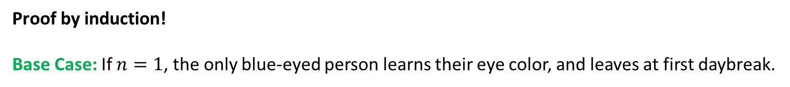
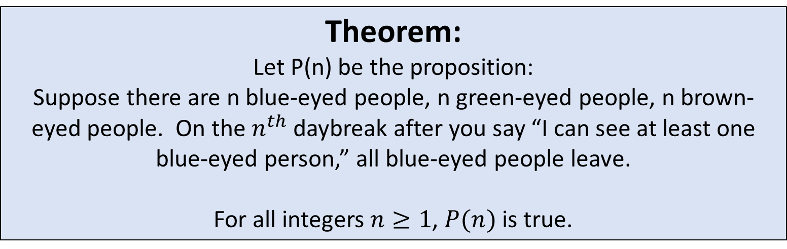
The Blue Eyes Paradox
Theorem:
Let P(n) be the proposition:
Suppose there are n blue-eyed people, n green-eyed people, n brown-eyed people. On the $n^{th}$ daybreak after you say “I can see at least one blue-eyed person,” all blue-eyed people leave.
For all integers $n≥1$, $P(n)$ is true.
Proof by induction!
Base Case: If $n=1$, the only blue-eyed person learns their eye color, and leaves at first daybreak.

Slide 10
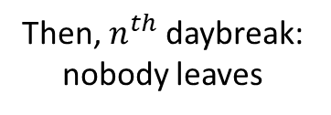
The Blue Eyes Paradox
Theorem:
Let P(n) be the proposition:
Suppose there are n blue-eyed people, n green-eyed people, n brown-eyed people. On the $n^{th}$ daybreak after you say “I can see at least one blue-eyed person,” all blue-eyed people leave.
For all integers $n≥1$, $P(n)$ is true.
Inductive step: Assume P(n), and try to show P(n+1)
There are n+1 blue, n+1 green, n+1 brown
I can see n other blue-eyed people, so there are either n or n+1 in total (not sure if I’m one of them)
Then, $n^{th}$ daybreak: nobody leaves
Each blue-eyed person thinks

Slide 11
The Blue Eyes Paradox
Theorem:
Let P(n) be the proposition:
Suppose there are n blue-eyed people, n green-eyed people, n brown-eyed people. On the $n^{th}$ daybreak after you say “I can see at least one blue-eyed person,” all blue-eyed people leave.
For all integers $n≥1$, $P(n)$ is true.
Inductive step: Assume P(n), and try to show P(n+1)
There are n+1 blue, n+1 green, n+1 brown
If there were n blue-eyed people, they would have all left (assuming P(n)). There must be n+1 blue-eyed people instead. I have blue eyes!
Then, $n^{th}$ daybreak: nobody leaves

Slide 12
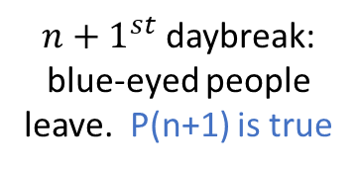
The Blue Eyes Paradox
Theorem:
Let P(n) be the proposition:
Suppose there are n blue-eyed people, n green-eyed people, n brown-eyed people. On the $n^{th}$ daybreak after you say “I can see at least one blue-eyed person,” all blue-eyed people leave.
For all integers $n≥1$, $P(n)$ is true.
Inductive step: Assume P(n), and try to show P(n+1)
There are n+1 blue, n+1 green, n+1 brown
If there were n blue-eyed people, they would have all left (assuming P(n)). There must be n+1 blue-eyed people instead. I have blue eyes!
${n+1}^{st}$ daybreak: blue-eyed people leave. P(n+1) is true

Slide 13
The Blue Eyes Paradox
300 people live on an island. 100 have blue eyes, 100 have green eyes, and 100 have brown eyes.
Nobody knows their own eye color.
Each daybreak, everyone who has learned their eye color must leave.
On 100th day, all blue-eyed people leave.
I can see someone with blue eyes
Yeah we already knew that
You said something that the islanders already knew, so they gained no information.
But their behavior changed, so they must have gained some information.
Which is it? Can you explain the paradox? It’s tricky!

